Slide 1
Chemistry Test 1 Revision Year 9 Chemistry

Slide 2
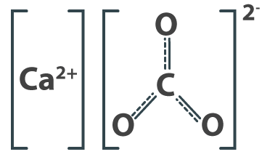
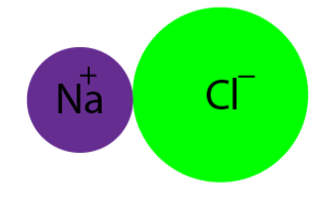
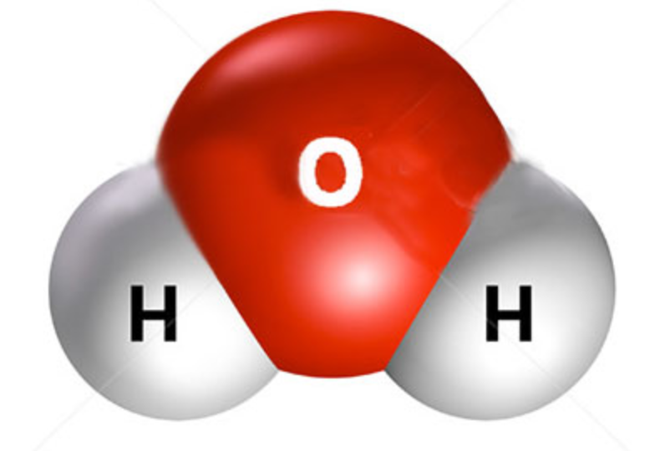
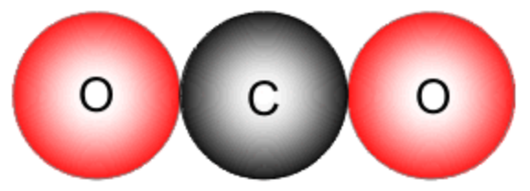
Concept Development
Types of Bonding
Ionic compounds are made when a metal atom bonds with a non-metal particle (atom or molecule).
e.g. Calcium carbonate: CaCO₃ Sodium chloride (table salt): NaCℓ
Covalent compounds are made when a non-metal atom bonds with another different non-metal atom.
e.g. Dihydrogen monoxide (water) Carbon dioxide

Slide 3
Concept Development
Naming Ionic Compounds [metal – non-metal]
Write the name of the metal first
Write the name of the non-metal second and change the ending to –ide
i.e. hydrogen → hydride
oxygen → oxide
nitrogen → nitride
chlorine → chloride
fluorine → fluoride
bromine → bromide

Slide 4
Concept Development
Naming Ionic Compounds [metal – non-metal]
Some ionic compounds have a group made of a non-metal and oxygen, bonded to a metal.
These groups have special names:
CO₃ → carbonate
SO₄ → sulfate
NO₃ → nitrate
They are named in a similar way to other ionic compounds.
Write the name of the metal first
Write the name of the non-metal group second with the ending of –ate

Slide 5
Concept Development
Naming Covalent Compounds [non-metal – non-metal]
Write the elements in the order they appear in the formula
A prefix is put in front of each element to show how many there are
If there is only one atom of the first element, no prefix is needed
The ending of the last element is changed to –ide
i.e. one = mono
two = di
three = tri
four = tetra

Slide 6
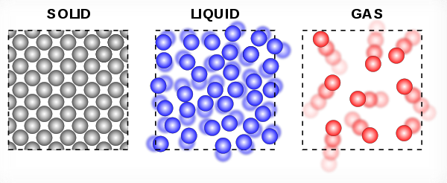
Concept Development
Matter
Matter is any substance that has mass and volume.
Matter can take many forms, including:
Solids – for example your chair
Liquids – for example water
Gases – for example oxygen
Matter is composed of tiny particles called atoms.
Atoms are usually represented as small, individual circles in diagrams.
However, atoms are themselves composed of even smaller parts, referred to as subatomic particles.
Vocabulary
Subatomic: smaller than, or occurring within, an atom

Slide 7
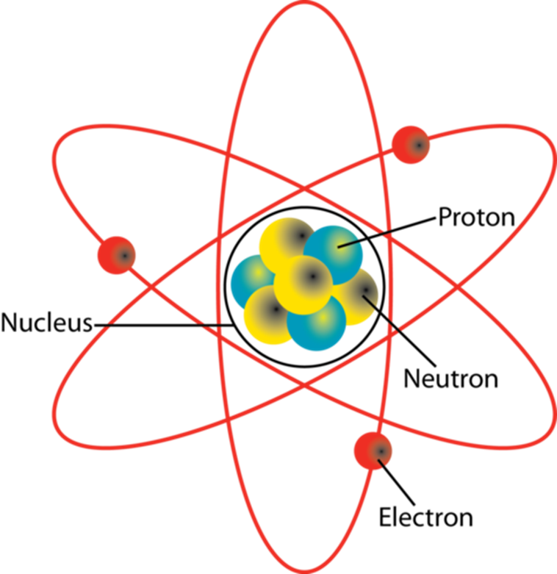
Concept Development
Structure of an Atom
Atoms are made of three subatomic
particles: protons, neutrons and electrons.
Protons and neutrons are found in the centre of an atom, which is called the nucleus.
Electrons orbit the nucleus at very high speeds.
Some subatomic particles have electrical charges:
Protons have a positive (+) charge
Electrons have a negative (-) charge
Neutrons are neutral and have no charge
Vocabulary
Subatomic: smaller than, or occurring within, an atom

Slide 8
Concept Development
Structure of an Atom
The number of protons in the nucleus of an atom determines which element the atom is.
All atoms of an element have the same number of protons.
For example, all carbon atoms have 6 protons.
This is referred to as the atomic number of the element.
Vocabulary
Subatomic: smaller than, or occurring within, an atom

Slide 9
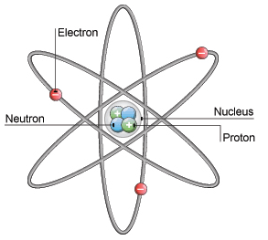
Concept Development
Structure of an Atom
A neutral atom has the same number of protons as electrons.
This means that the number of positive charges equals the number of negative charges.
The charges balance each other, so the entire atom has no charge.
For example, the atom in the picture has three positive protons and three negative electrons, so it has no overall charge.
Vocabulary
Subatomic: smaller than, or occurring within, an atom

Slide 10
Concept Development
Structure of Atoms
Atoms are made of three subatomic particles: protons, neutrons and electrons.
Protons and neutrons are found in the centre of an atom, which is called the nucleus.
Electrons orbit the nucleus at very high speeds.
Vocabulary
Subatomic: smaller than, or occurring within, an atom

Slide 11
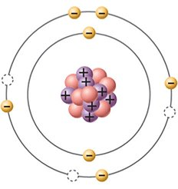
Concept Development
Atomic Number
Atoms of the same element all have the same number of protons in their nucleus.
The number of protons is called the atomic number.
For example, all atoms of carbon have 6 protons, so its atomic number is 6.
Vocabulary
Subatomic: smaller than, or occurring within, an atom

Slide 12
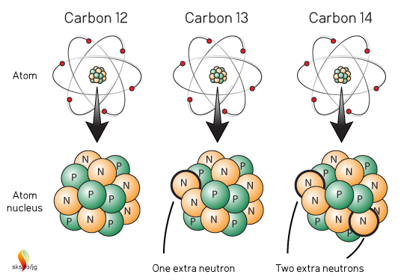
Concept Development
Isotopes
Atoms of the same element all have the same number of protons, but the number of neutrons can be different.
Atoms of the same element with different numbers of neutrons are called isotopes.
For example, carbon isotopes all have 6 protons, but they have different numbers of neutrons (6, 7, and 8).
Vocabulary
Subatomic: smaller than, or occurring within, an atom

Slide 13
Concept Development
Atomic Mass
The mass of an atom is determined by the mass of its nucleus.
Electrons are so light compared to protons and neutrons that they are usually not considered.
On the relative atomic scale, protons and neutrons both have masses of approximately 1 amu (atomic mass unit).
This allows us to work out the total mass of an atom by adding the number of protons and neutrons.
Vocabulary
Subatomic: smaller than, or occurring within, an atom
Notes:
1.007 (p) and 1.009 (n) if you want to be more exact

Slide 14
Concept Development
Atomic Mass Number
The mass number of an atom is found by adding the number of protons and neutrons.
Different isotopes are written with their atomic mass numbers after the element name, e.g. helium-4 or helium-5.

Slide 15
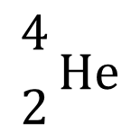
Concept Development
Atomic Symbols
An atomic symbol is a way of representing a specific isotope of an element.
An atomic symbol always includes:
The symbol of the element
The atomic number (in front of and below the element symbol)
The mass number (in front of and above the element symbol)
This helium atom can be represented as:
mass number (protons + neutrons)
$${4 \atop 2}\text{He}$$
Vocabulary
Subatomic: smaller than, or occurring within, an atom
atomic number (protons)
element symbol

Slide 16
Concept Development
Atomic Symbols
An atomic symbol always includes:
The symbol of the element
The atomic number (in front of and below the element symbol)
The mass number (in front of and above the element symbol)
Vocabulary
Subatomic: smaller than, or occurring within, an atom

Slide 17
Concept Development
Structure of Atoms
Atoms are made of three subatomic particles: protons, neutrons and electrons.
Protons and neutrons are found in the centre of an atom, which is called the nucleus.
Electrons orbit the nucleus at very high speeds.
In a neutral atom, the number of protons is equal to the number of electrons.
Vocabulary
Subatomic: smaller than, or occurring within, an atom

Slide 18
Concept Development
Electron Shells
Electrons do not orbit the nucleus randomly, they occupy specific areas of space around the nucleus.
These areas are called electron shells.
Each shell can only hold a limited number of electrons.
The first shell holds up to 2 electrons
The second shell holds up to 8 electrons
The third shell holds up to 18 electrons
The arrangement of electrons in an atom is called its electron configuration.
Vocabulary
Subatomic: smaller than, or occurring within, an atom

Slide 19
Concept Development
Electron Shells
Electron shells are filled in a predictable way.
The first 2 electrons go in the first shell, one on each side.
The next 4 electrons go in the second shell, starting at the top and moving clockwise.
The next 4 electrons, go in the second shell and form pairs with the other electrons.
The third shell fills in the same way as the second.
Nucleus
Vocabulary
Subatomic: smaller than, or occurring within, an atom

Slide 20
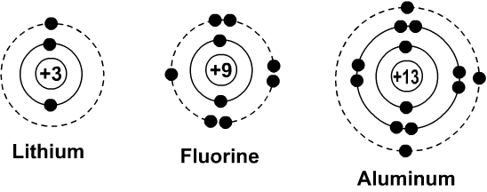
Concept Development
Electron Shells
The outermost electron shell is called the valence shell.
The chemical properties of an element are determined by the number of electrons in the valence shell.
Elements with the same number of valence electrons react in similar ways.
Vocabulary
Subatomic: smaller than, or occurring within, an atom

Slide 21
Concept Development
Electron Configuration
The arrangement of electrons in each shell can also be represented using numbers.
The number of electrons in each shell is listed in order from the innermost shell to the outermost shell.
The numbers are separated by commas.
For example, the electrons in the nitrogen atom can be shown as: 2, 5
Vocabulary
Subatomic: smaller than, or occurring within, an atom

Slide 22
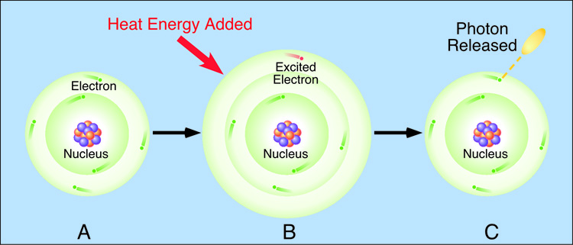
Concept Development
Excited Electrons
In an atom, the electrons orbit the nucleus in particular spaces, called electron shell.
When energy (often thermal or electrical) is added to the atom, the electrons in the outermost shell can jump to a shell further away from the nucleus.
When an electron has jumped to a higher electron shell, it is called an excited electron.

Slide 23
Concept Development
Excited Electrons
Excited electrons cannot stay in the higher shell, so they drop back to their original shell.
When they do this, light (photons) is emitted.

Slide 24
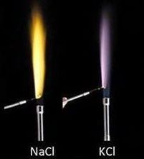
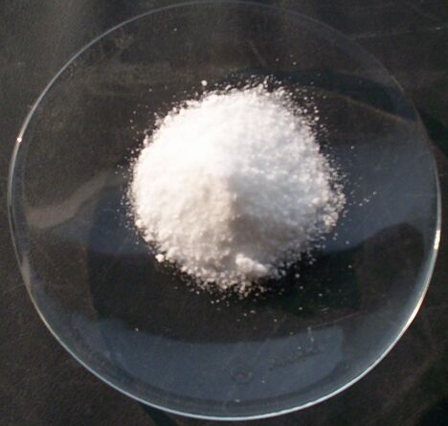
Concept Development
Colours of Light Emitted
The colour of light emitted changes depending on the element and can be used to identify different elements.
For example, compounds containing sodium will produce a yellow colour, whereas potassium produces a pale purple.

Slide 25
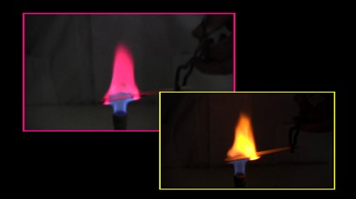
Skill Development/Guided Practice
You are going to conduct an experiment to observe the colours emitted by different metallic elements.
You will hold a pop stick soaked in a solution of a compound containing the element in a Bunsen burner flame and record how the colour of the flame changes.
You will need to wear safety glasses while using the Bunsen burner

Slide 26
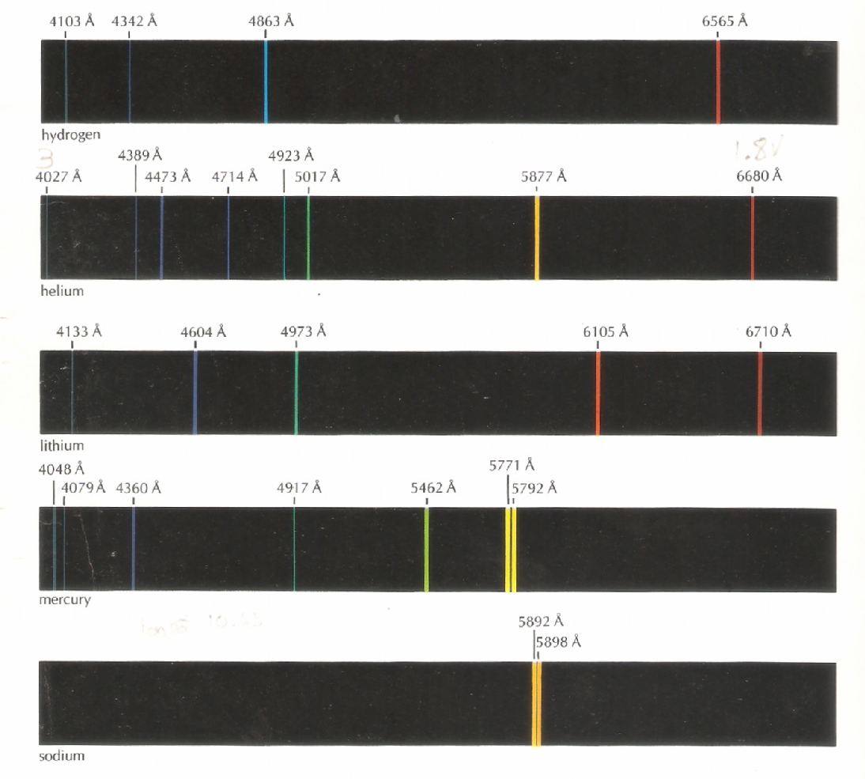
Relevance
The colours emitted by different compounds can be used to help identify the metallic element in the compound.
Each element emits a unique combination of colours, which can be analysed to determine the element. Some colours emitted by different elements are shown in the picture.

Slide 27
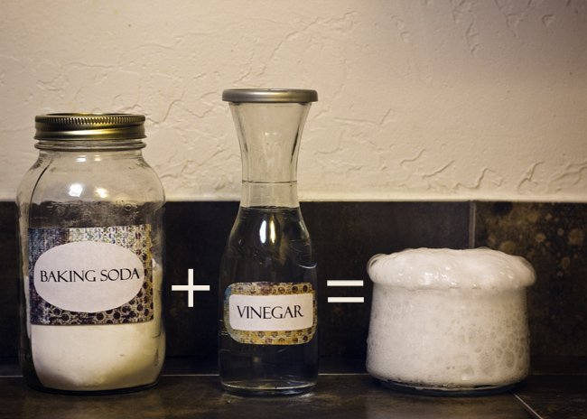
Concept Development
During a chemical reaction, the different elements in the starting substances are rearranged to form new substances.
In a chemical reaction, one or more new substances are formed. These are the products of the reaction.
The substances you start with in a chemical reaction are called the reactants.

Slide 28
Concept Development
The products are the substances formed in the reaction.
The starting substances are called the reactants.
When sodium metal is put into water, it reacts violently to form hydrogen gas and sodium hydroxide.

Slide 29
Concept Development
The products are the substances formed in the reaction.
The starting substances are called the reactants.
When magnesium is burnt, it reacts with oxygen in the air to form magnesium oxide.

Slide 30
Concept Development
The products are the substances formed in the reaction.
The starting substances are called the reactants.
When it is heated, hydrogen peroxide breaks down into water and oxygen.

Slide 31
Concept Development
Chemical reactions can be written as chemical equations using words and symbols.
In a chemical equation, the reactants are always written first.
Multiple reactants are separated by a plus (+) sign.
The products are always written second.
Multiple products are separated by a plus (+) sign.
The two sides of the reaction are joined by an arrow (→) pointing towards the products.
Reactants
Sodium + Water
Products
Hydrogen + Sodium hydroxide
→

Slide 32
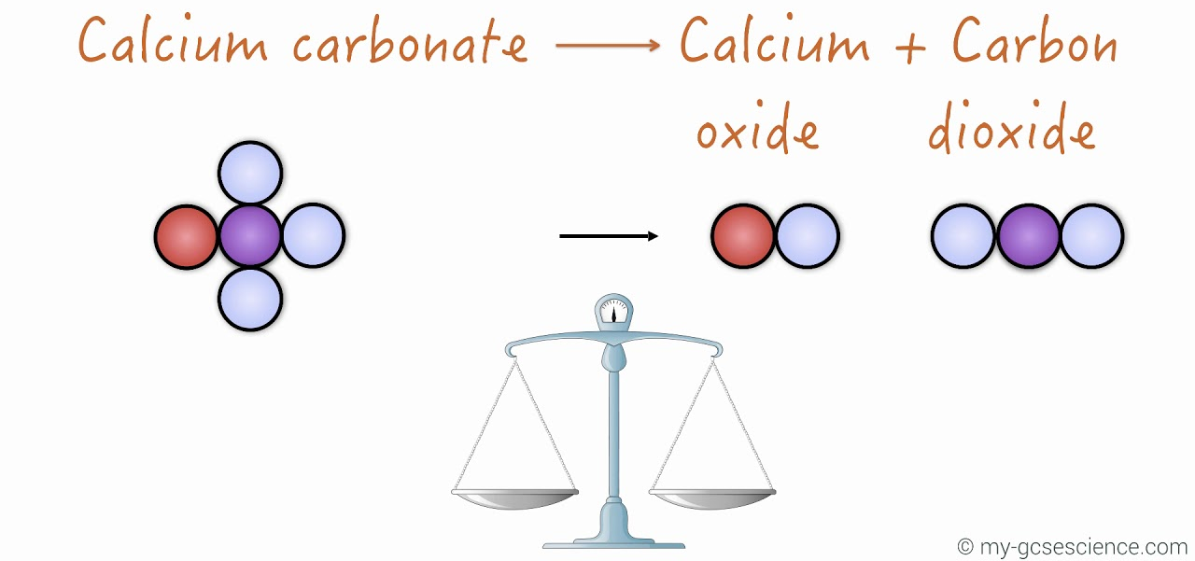
Concept Development
Law of Conservation of Mass
When a chemical reaction takes place, the molecules in the reactants break apart.
The atoms then rearrange to form the products.
During this process, no new atoms are produced and no atoms are destroyed.
This is called the Law of Conservation of Mass.

Slide 33
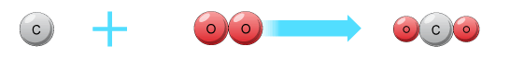
Concept Development
Formula Equations
Chemical reactions can be represented using word equations, for example:
Carbon + Oxygen → Carbon dioxide
Chemical reactions can also be represented using chemical formulae (plural of formula).
This shows how many atoms of each element are present, for example the equation above can be written as:
C + O₂ → CO₂

Slide 34
Concept Development
Formula Equations
Mass is conserved in a chemical reaction.
The number of atoms of each element is the same before the reaction and after the reaction.
When the number of atoms of each element are the same before and after, the equation is balanced.
For example, the equation C + O₂ → CO₂ is balanced.
There is one carbon atom on each side and two oxygen atoms on each side.
H₂SO₄ + Na → NaSO₄ + H₂

Slide 35
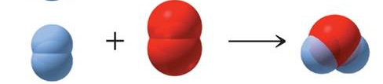
Concept Development
Formula Equations
When the number of atoms of each element are the not same before and after, the equation is unbalanced.
For example, the equation H₂ + O₂ → H₂O is unbalanced.
There are two hydrogen atoms on each side, but two oxygen atoms on the reactants side and one oxygen atom on the products side.
HCℓ + Mg → MgCℓ₂ + H₂ CuCO₃ → CuO + CO₂

Slide 36
Concept Development
Balancing Formula Equations
To balance an equation, a number is written before one or more chemical formulae.
This is called a coefficient.
The coefficient shows how much of each substance is needed.
2 HCℓ + Mg → MgCℓ₂ + H₂
The coefficient in front of HCℓ means there are 2 HCℓ molecules for each magnesium atom.
2H₂ + O₂ → 2H₂O

Slide 37
Concept Development
Balancing Formula Equations
The coefficient multiplies all the atoms in the substance by that number.
2HCℓ + Mg → MgCℓ₂ + H₂
The 2 in front of the HCℓ means there are now 2 hydrogen atoms and 2 chlorine atoms on the reactants side of the equation.

Slide 38
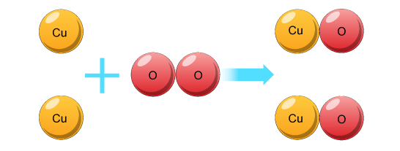
Skill Development / Guided Practice
Balancing Formula Equations
List the number of each type of element on both sides of the equation.
Choose an element that has unequal numbers
Add coefficients to make them equal and adjust the numbers of elements in the list.
Choose another element that has unequal numbers, add coefficients and adjust the list.
Continue until all elements have equal numbers.
Copper + Oxygen → Copper oxide
Cu + O₂ → CuO
2
2
Cu = 1
O = 2
2
Cu = 1
O = 1
2
2

